Slide 1
INTRODUCTION TO PLANT DIVERSITY

Slide 2
CLASSIFICATION OF LIVING THINGS
There are at least 5 million different kinds of organisms in the biosphere and this great diversity necessitated the classification of living things into groups with similar characteristics.
Taxonomy is the scientific discipline that deals with the classification of living things.
The practice of referring to organisms by Latin names began in the middle ages (i.e. between the 5th and 15th centuries) when Latin was the language of scholarship.

Slide 3
Initially, organisms were grouped into genera (singular: genus) and were then identified by descriptive Latin phrase names, known as polynomials.
For example, catnip (also known as catmint, catswort or “marijuana for cats”) was referred to as Nepeta floribus interrupte spicatus pedunculatus (meaning “Nepeta with flowers in an interrupted pedunculate spike”).
By the end of the 17th century, the first word in such a polynomial was widely accepted to designate the name of the group, or genus, to which an organism belonged.
Thus, phrases describing the different kinds of roses began with the genus name Rosa; all oak trees were identified with polynomials beginning with the word Quercus, and those referring to willows began with the word Salix.

Slide 4
Simpler system of classification of living things was introduced by the 18th century Swedish professor and naturalist, Carolus Linnaeus, whose two-volume publication (Species Plantarum) in 1753 contained brief analytical descriptions of every known species of plant at that time.
Although in the Species Plantarum Linnaeus used polynomial designations and regarded them as the “proper” names for the species, he also added an important innovation to the system. In the margin of his publication, next to the proper names, he entered a single word which, together with the generic name, formed a convenient “shorthand” designation for the species.
For example, taking into consideration a more familiar characteristic of the catnip plant, Linnaeus entered “cataria” (meaning “cat-associated”) in the margin next to its proper name; thus renaming it Nepeta cataria. The convenience of this binomial system of classification made it very popular and explains why it has remained in use till date.

Slide 5
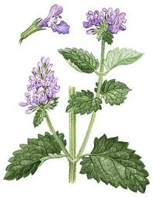
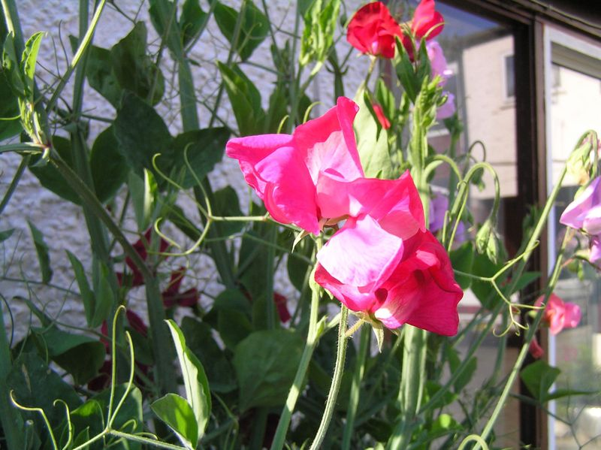
In general, the scientific name of every species is a binomial consisting of two words – the generic name and the specific name. Thus the sweet pea (an annual leguminous climber native to the eastern Mediterranean) is scientifically known as Lathyrus odoratus. Lathyrus is the Greek word for pea and odoratus is a latin word meaning fragrant or perfumed. Note that usually an effort is made to ensure that the specific name (or species name) is descriptive.

Slide 6
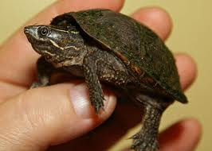
specific name is meaningless when written alone. For example, odoratus could refer to any of the several different species of organisms that happen to have this word as part of their name.
Incidentally, Sternotherus odoratus is a small turtle that is native to southeastern Canada and much of the eastern United States. It is also known as the common musk turtle or stinkpot due to its ability to release a foul musky odour from scent glands on the edge of its shell, possibly to deter predation.

Slide 7
Since a specific name could refer to a plant or animal species, as shown in the above examples, it is important that a specific name is always preceded by the name or initial letter of the genus in question; e.g. Lathyrus odoratus or L. odoratus. Scientific names are always printed in italics or are underlined when written or typed.
It is not uncommon, particularly among cultivated plants, to have new races develop within a species. Thus species can be further divided into subspecies or varieties. The scientific names of subspecies or varieties may consist of three parts. For example, Lathyrus odorata var. nanellus is a trinomial referring to the dwarf sweet pea.

Slide 8
It is worth noting that the genus of a species is only one level of classification of living things. Linnaeus (and earlier scientists) recognized three main types of “objects” in nature; namely plant, animal and mineral. Thus living things belonged to either the plant or animal kingdom, and till date “kingdom” remains the major unit in biological classification. In the 19th and 20th centuries, however, other levels of classification were added between the level of genus and the level of kingdom as shown below.
Genus → Family → Order → Class → Division (or Phylum) → Kingdom
Thus, genera are grouped into families, families into orders, orders into classes, and so on. The term “Phylum” (plural: Phyla) is equivalent to “division”, but it is not recognized by the International Code for Botanical Nomenclature and, hence, is used only in zoological classification.

Slide 9
THE MAJOR GROUPS OF LIVING THINGS
A classification that depicts genetic relationships is said to be a natural or phylogenetic classification. Differences in photosynthetic pigments, manner of leaf development, structure of the conducting or vascular tissues, and modes of reproduction are some of the important features that are considered in separating plants into divisions.

Slide 10
Early taxonomists classified living things as either plant or animal. By definition, animals could move, eat breathe and had bodies that were definitely limited in size.
Plants, on the other hand, could not move, eat or breathe, and were presumed to manufacture their own food and seemed to grow indefinitely.
Thus, initially, fungi and bacteria were grouped with the plants and protozoa (e.g. Amoeba) were grouped with the animals.
However, taxonomists began to have challenges with organisms such as Chlamydomonas, which moves and manufactures its own food. Clearly, such an organism could not be classified as either plant or animal, and by the 1930s, it was evident that the traditional classification of living things into two distinct kingdoms needed to be revised.
With the accumulation of new information, it has become evident that the most fundamental distinction in living organisms is that between the prokaryotes and the eukaryotes.

Slide 11
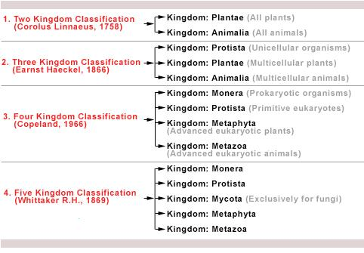

Slide 12
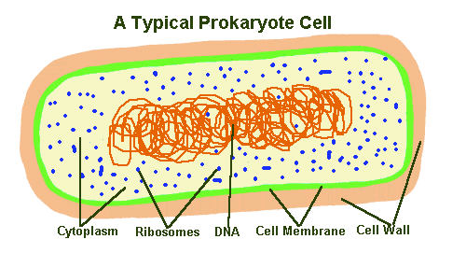
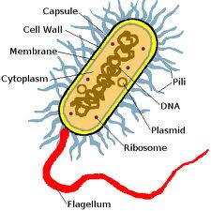
PROKARYOTES do not have true nuclei, i.e. their nuclei are not bound by a membrane.
prokaryotic organisms lack membrane-bound cellular organelles, microtubules and the advanced 9-plus-2 structure of flagella.
Their genetic material is contained in a single circular molecule of DNA that is not associated with proteins.
Although genetic recombination is known to occur in prokaryotes, it is achieved through division mechanisms other than sexual reproduction.

Slide 13
Reproduction is predominantly by cell division, and the mode of nutrition is mainly by absorption, although some are photosynthetic or chemosynthetic (Chemosynthesis is an alternate way to generate energy and make sugars to photosynthesis. Instead of using light as the energy source, chemosynthetic organisms use some chemical as the energy source. Typical chemicals for this are hydrogen sulfide, hydrogen or ammonia).
They exhibit solitary unicellular or colonial unicellular organization, and are either motile by simple flagella or by gliding, or are non-motile.
The cell walls of most prokaryotes contain muramic acid, and this and other biochemical peculiarities distinguish them from all other organisms.
Prokaryotes are, therefore, recognized as a separate kingdom – the Kingdom Monera, which comprises all bacteria including cyanobacteria (the blue-green algae).

Slide 14
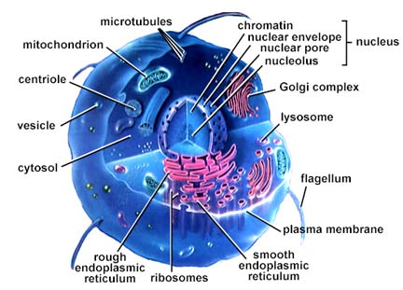
EUKARYOTES, on the other hand, have a definite nucleus bounded by a double membrane.
Within the nuclear envelope are complex chromosomes in which the DNA is associated proteins.
All eukaryotic organisms possess complex cellular organelles such as mitochondria, and most, especially plants, have vacuoles that are bounded by a single membrane or tonoplast.

Slide 15
Many eukaryotes also exhibit two important features that are absent in prokaryotes – integrated multicellularity and sexual reproduction.
Although the cells of prokaryotes may remain together in filamentous or even three-dimensional masses following cell division, there is no overall integration of the entire mass due to the absence of protoplasmic connections between the individual cells.
In plant eukaryotes, however, the protoplasts of contiguous cells are connected by plasmodesmata, whereas in animals the protoplasts are in more direct contact due to the absence of cell walls.

Slide 16
THE FIVE-KINGDOM CLASSIFICATION
One formal classification of living things divides them among five kingdoms: the kingdom Monera, which contains all prokaryotes, and four eukaryotic kingdoms; namely Protista (same as Protoctista), Fungi, Animalia, and Plantae.
The kingdom Protista is believed to have evolved from the kingdom Monera and the three other kingdoms are believed to have evolved separately from the kingdom Protista; fungi appearing first, followed by animals and then plants.

Slide 17
GENERAL BIOLOGY OF FUNGI
The fungi are heterotrophic organisms (not capable of preparing their own food) which vary in form and size.
The main body of a fungus usually consists of numerous fine branching threads, called hyphae, which together form a tangled mass called the mycelium.
They lack chlorophyll and their cell walls contain chitin – a characteristics of animal cells.

Slide 18
Fungi occur both on land and in water. They may be parasitic (e.g. Phythophthora sp. – causes black pod disease in cocoa) or saprophytic (e.g. Termitomyces sp. - absorb their nutrients from dead organic matter). A few also form symbiotic relations with other organisms, especially higher plants as mycorrhizae (e.g. Glomus spp.).
Fungi reproduce both sexually and asexually. Bud formation in yeast and sporulation in Rhizopus spp. is an example of asexual reproduction. However note that both yeast and Rhizopus spp. also exhibit sexual reproduction.

Slide 19
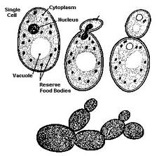
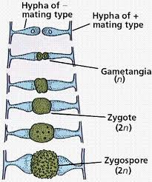
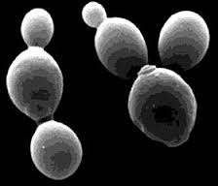

Slide 20
FUNGAL STRUCTURE
There are three major forms of fungi:
single celled microscopic forms - yeasts
multicellular filamentous forms - moulds
macroscopic filamentous (hyphae forms with large fruiting bodies – mushrooms, puff balls. Note that mushrooms and puff balls are just the fruiting bodies which we see above ground. Underneath there exists a whole system of hyphae.

Slide 21
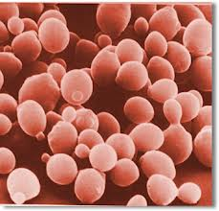
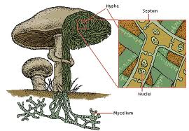
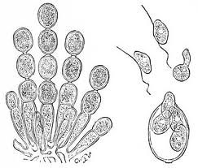

Slide 22
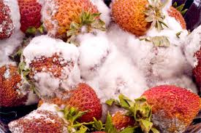
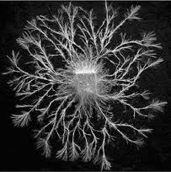
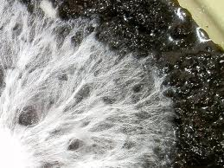
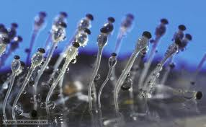
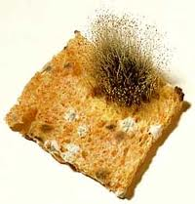
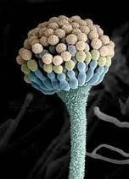
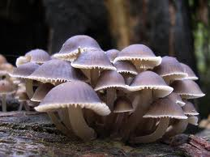
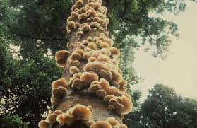
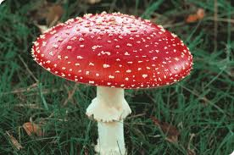

Slide 23
ECONOMIC IMPORTANCE OF FUNGI
Recycling
Fungi, together with bacteria decompose dead organic material thus releasing nutrients back into the ecosystem. This activity greatly enhances soil fertility, thus promoting crop productivity. Without fungi, this recycling activity would be highly reduced and we would effectively be lost under piles of dead plant and animal remains, many meters thick.
Mycorrhizae and plant growth Some fungi are vitally important for plant growth and development through mycorrhizal associations with plant roots. This enhancement of the growth of primary producers is ultimately beneficial to the entire food chain.

Slide 24
Food Fungi are consumed either directly as food or used indirectly in food and beverage industry. Many mushrooms are edible and mushroom cultivation is a commercially viable venture practiced worldwide. E.g. Truffle (Tuber spp.) – are rare, wild, edible and very expensive variety considered a delicacy due to its intense aroma and characteristics flavour.
Cheeses, beer and wine, bread, some cakes, corn dough and some soya bean products all benefit from fungal activity. It is important to correctly identify mushrooms before harvesting and consumption since some are deadly poisonous. E.g. Amanita phalloides: the death cap mushroom.
Medicines Fungi produce antibiotics which are widely used medicinally to control diseases in both human and animal populations. The most famous of all antibiotic drugs Penicillin, is derived from a common fungus called Penicillium notatum.
Biocontrol Some fungi have been used in biological control of pests. E.g. Chinese caterpillar fungus (Cordyceps sinensis), which parasitises insects. The spores of the fungi are sprayed on the crop pests which results in the growth of fungal hyphae in the insects and eventually kills it.
Fungi are also used to control nematodes in the soil. E.g. Trichoderma viride is inoculated into the soil and the hyphae penetrates the nematodes ultimately killing them.

Slide 25
Crop Diseases Fungi have great economic importance as they cause the majority of known plant diseases. Most of our common crop plants are susceptible to fungal attack of one kind or another. Fungal diseases can on occasion result in the loss of entire crops if they are not treated with antifungal agents. E.g. Famous Late blight of potato (Phyptophthora infestans) that caused death by starvation in Ireland, Corn smut disease caused by Aspergillus niger destroys the corn cobs.
Animal Disease Fungi can also parasitise domestic animals causing diseases, but this is not usually a major economic problem. Ringworm and Candida infections are examples of human fungal infections. A wide range of fungi also live on and in humans, but most exist harmlessly.
Spoilage of food and goods Fungi causes spoilage of food (e.g. fruits, tubers, vegetables, preserves) and other consumable goods like fabric, leather, paper, etc. It also causes rotting of wood. Aspergillus spp. are known to produce aflatoxins in most grains and nuts. Chronic dietary exposure to aflatoxins has been shown to cause liver cancer in humans.

Slide 26
GENERAL CHARACTERISTICS OF ALGAE
Algae are a heterogeneous group of organisms. They range from microscopic to macroscopic forms. They are mostly aquatic – fresh and marine water. The may be found in semi-permanent pools, ponds, lakes, streams, along ocean shore lines and in the surface waters of oceans. Some algae are terrestrial and may be found on rock or wood surfaces living in symbiotic association with other organisms, especially fungi, as lichens.
Most algae are autotrophic plants having chlorophyll but the latter is masked by other pigments resulting in blue-green, brown and red forms. Aquatic algae do not grow beyond certain depths since water tends to absorb the sunlight necessary for photosynthesis. They may be either free floating or attached to logs, rocks or other submerged objects. Small free floating algae are referred to as phytoplankton.

Slide 27
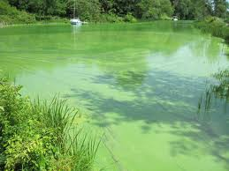
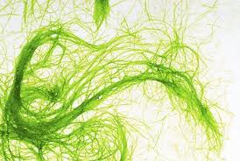
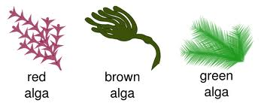
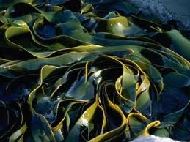
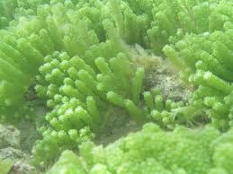

Slide 28
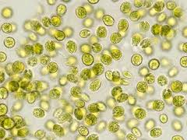
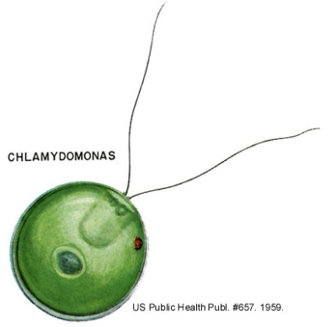
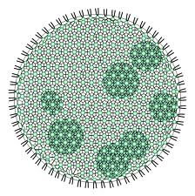
Reproduction in algae is by three main methods: a) sexually, b) asexually and c) vegetatively by fragmentation.
ALGAL STRUCTURE
Non motile unicellular (sedentary) form – the cells are commonly small and spherical without any flagella. E.g. Chlorella
Unicellular motile form – single celled, oval /pear shaped with two flagella. E.g. Chlamydomonas
Motile coenobial form – colony of flagellated cells surrounded by gelatinous matrix through which the flagella protrude. E.g. Volvox sp.

Slide 29
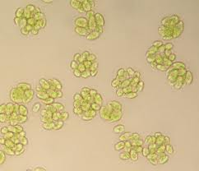
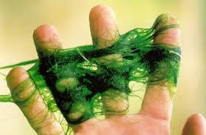
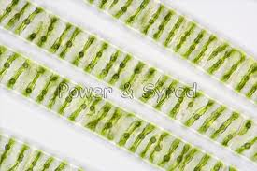
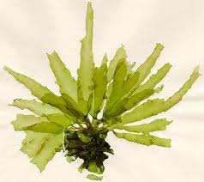
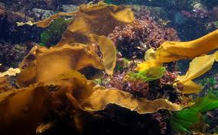
Non Motile coenobial form – colony of cells without flagella. E.g. Scenedesmus sp.
Filamentous form – consisting of chains of cells joined into threads. The filaments may be branched or unbranched (e.g. Spirogyra) or may consist of false/pseudo branches.
Thalloid form – compact multicellular body with flattened photosynthetic parts and holdfast for anchorage. E.g. Ulva sp.
Special forms – complex thallus structure consisting of annual and perennial parts with meristematic region in between. E.g. Laminaria agardhii

Slide 30
ECONOMIC IMPORTANCE
Algae are a link in the food chain –few chlorophyll containing algae are autotrophic synthesizing their own food using energy from sunlight and they are a source of food for fish.
Algae are useful in fish culture – in fish farming; algae are very important source of feed for fish.
Harmful algal blooms - Few toxic algae also cause loss of fish through fish kills.
Algae used in sewage treatment plants – green unicellular algae are used in sewage treatment plant to provide oxygen from photosynthesis which is then used by bacteria for rapid decomposition of sewage.
Algae used in petroleum and gas industry – it is believed that fossil fuel originated from organic matter in marine environment. Marine algae contributed significantly to this source of organic matter. Some algal varieties eg. Diatoms have high lipid content which serve as a source of bio-fuel.

Slide 31
Algae and limestone formation – algae also form extensive deposits of limestone as they accumulate calcium carbonate in their cell walls. Eg. Blue green (fresh water) and red algae (marine).
Algae as food – various kinds of algae have been used in human diet since ancient times especially in China and Japan. Algae are rich in vitamins A and E, and also contain vitamins C and D. Man therefore obtains carbohydrates, vitamins and inorganic substances (e.g. Iodine). Spirulina also has a high protein content (50-70% of algal dry weight) and hence shows promise for use as a food supplement.
Algae used as fodder – algae have been extensively used as stock feed in various parts of the world (e.g. Europe).

Slide 32
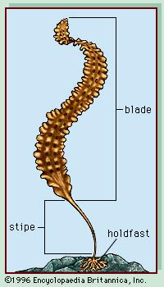
Algae used as fertilizer – some blue-green algal species (Anabaena sp., Nostoc sp.) have nitrogen fixing capabilities and are introduced in paddy fields for yield improvement.
Algae as medicine – Sargassum sp. has been used for treating goitre and other glandular problems. Dried stipes of Laminaria sp. have been used in the expansion of the cervix in child birth due to its ability to swell gently on exposure to water.
Industrial uses of algae – algae can be used in the production of agar, kelp and algin.

